Slide 1
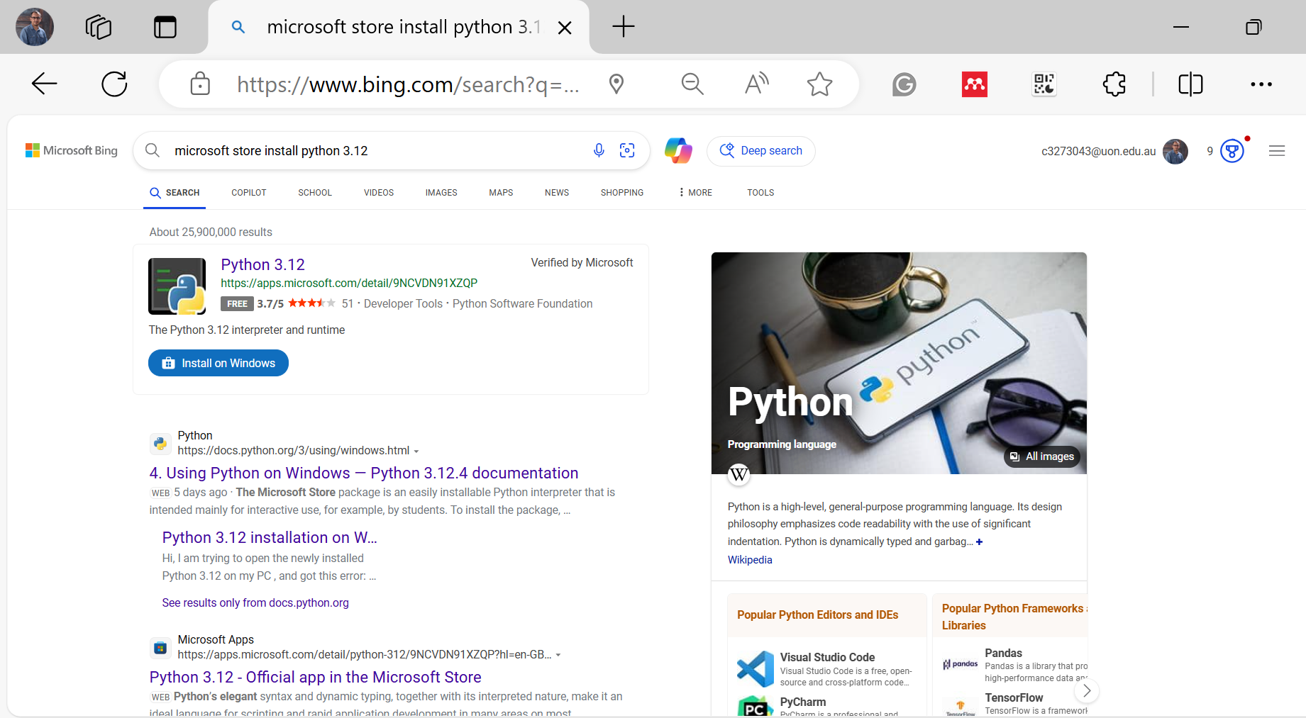
How to Install Python
1. Installing Python and setting up the development environment:
Python 3.12 - Free download and install on Windows | Microsoft Store

Slide 2
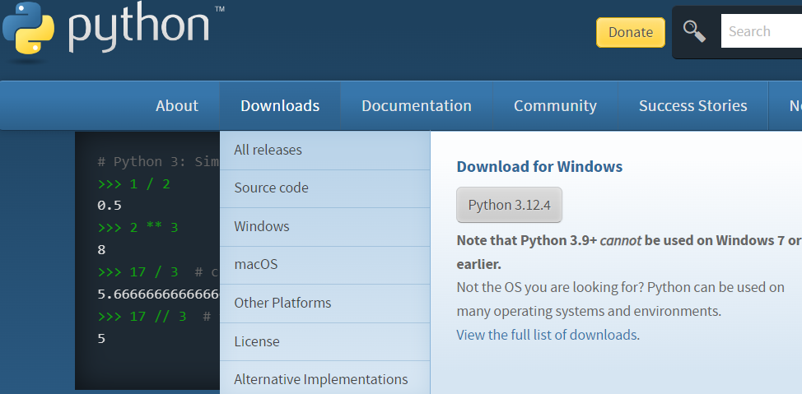
How to Install Python
Or
Download Python: Download the version compatible with your operating system (Windows, macOS, Linux/Unix) from https://www.python.org/
Install Python: Follow the installation steps, make sure to check the option "Add Python to PATH" during the installation.

Slide 3
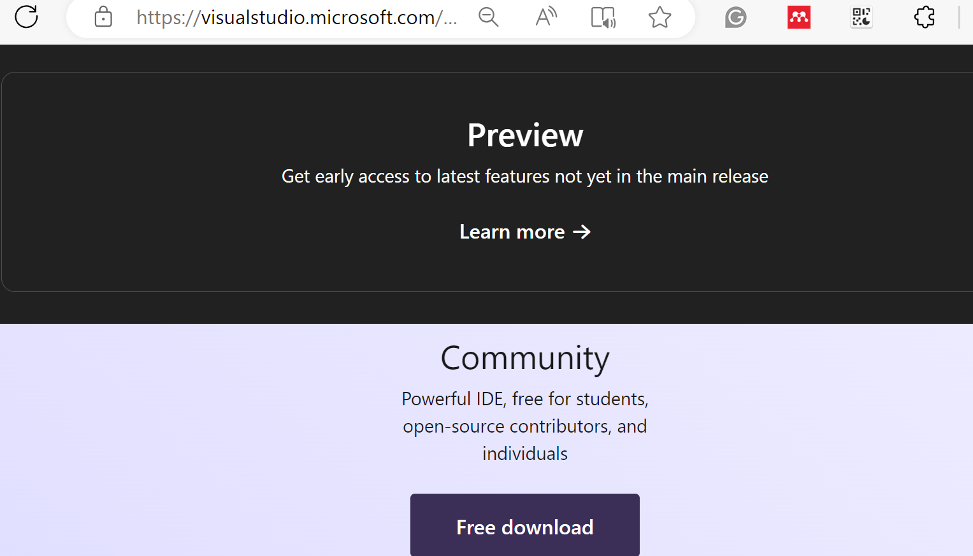
How to Install Visual Studio
2. Installing Visual Studio:
Installing Visual Studio Software: https://visualstudio.microsoft.com/downloads/
Choose the edition: Community, Professional, and Enterprise. The Community edition is suitable for research, academic, and small professional teams. The enterprise versions have more features and are paid.
Click on Download.
Install the file.
Choose the workload: Desktop development with C++, ASP.NET for web development, Mobile development with Xamarin.
Select a Microsoft account (optional) for access to additional services and synchronization of settings across different devices.

Slide 4
Python Installation - Mac
More Resources
More resources:
Davis, A. (2019, July 22). Installing Python on a Mac - Programming foundations: Fundamentals [Video]. LinkedIn Learning. & Installing Visual Studio Code on a Mac (linkedin.com)
Davis, A. (2019, July 22). Running Python on the command line on Mac - Programming Foundations: Fundamentals [Video]. LinkedIn Learning.

Slide 5
Python Installation - Windows
More Resources
More resources:
Davis, A. (2019, July 22). Installing Python on Windows - Programming Foundations: Fundamentals [Video]. LinkedIn Learning.
Davis, A. (2019, July 22). Running Python on the command line on Windows - Programming Foundations: Fundamentals [Video]. LinkedIn Learning.

Slide 6
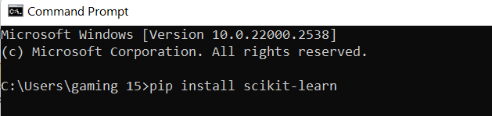
Installing Essential Libraries
3. Installing essential libraries: Type ‘cmd’ in windows to open command prompt and install any necessary library
SQLite: For database-related tasks (used for CRUD operations).
Tkinter: For creating the GUI application.
unittest: For testing Python applications.
NumPy and Pandas necessary for the project involving any data manipulation or analysis.

Slide 7
Installing Different Libraries
Data Visualization Libraries
Matplotlib
Comprehensive library for creating static, animated, and interactive visualizations.
pip install matplotlib
Seaborn
Statistical data visualization based on Matplotlib.
pip install seaborn
Plotly
Interactive graphing library.
pip install plotly

Slide 8
Installing Different Libraries
Additional Libraries:
Jupyter Notebook: Essential for creating and sharing documents that contain live code, equations, visualizations, and narrative text.
pip install notebook
Plotly: A library for interactive, web-based visualizations.
pip install plotly
Statsmodels: Useful for estimating and testing statistical models
pip install statsmodel

Slide 9
Installing Different Libraries
Additional Libraries:
NLTK/Spacy
Libraries for natural language processing (NLP).
pip install nltk
pip install spacy
OpenCV
Library for computer vision tasks.
pip install opencv-python

Slide 10
Installing Different Libraries
Additional Libraries:
Requests
Library for making HTTP requests.
pip install requests
BeautifulSoup4
Library for web scraping purposes to pull the data out of HTML and XML files.
pip install beautifulsoup4

